Slide 1
VOTIFY
by
Priyanshu 240843120092
Sapna Singh Lodhi 240843120069
Dipesh Patel 240843120028
Zaid Khan 240843120089

Slide 2
ABSTRACT
We are developing an Online voting system by taking advantage of the mysql database and with a web interface.
The main concept of this project is to build a website, which should be able to allow pepople to cast their vote by online.
Time saving, working load reduced, information available at time and it provide security for the data.
Real-Time Vote Counting – Automates vote collection and counting, minimizing manual errors and ensuring accurate results.
Remote Voting Advantage – Enables people to vote without physical presence, ensuring participation even in remote or pandemic situations.

Slide 3
INDEX
1. INTRODUCTION
2. PROBLEM STATEMENT
3. APPROACH TO SOULTION
4. SYSTEM ARCHITECTURE
5. TECHNOLOGY USED
6. LIVE DEMO
7. APPLICATION
8. CONCLUSION

Slide 4
1. INTRODUCTION
• An VOTIFY is a web based system that facilated the running of election and surveys online.
• VOTIFY provides the online registration form for the usres before voting and makes the users to cast their vote online.
• The system is to be developed with high security and user friendly.

Slide 5
2. PROBLEM STATEMENT
1. Security and Fraud Prevention: Traditional voting systems are vulnerable to manipulation, fraud, and security breaches, leading to a lack of trust in election results. Online voting introduces new risks such as hacking, vote tampering, and identity theft, making it crucial to implement strong encryption, voter authentication, and blockchain-based security to ensure transparency, integrity, and anonymity of votes. The challenge is to develop a secure system that guarantees each vote is cast by an eligible voter and remains unaltered.
2. Accessibility and Digital Divide: A major challenge in implementing an online voting system is ensuring that all citizens, regardless of location or technical knowledge, can participate in elections. Many people, especially in rural areas or developing regions, lack reliable internet access or digital literacy, making it difficult for them to vote online. The system must be designed to be user-friendly, mobile-compatible, and accessible on low-bandwidth connections, ensuring inclusivity while maintaining security and ease of use.

Slide 6
3.APPROACH TO SOLUTION
• If a secure and convenient electronic voting system is provided, it will be used more frequently to collect pepole’s opinion for much kind of political and social decison through cyber space.
• This system has been develoed to simplify the process of organising electronic and make it convient for voters to vote remotly from their home computers while taking into consideration security, anonymity and providinf auditioning capabilites.
User-Friendly Interface – Provides a simple, intuitive, and accessible web interface that allows even non-tech-savvy users to vote with ease.
Fraud Prevention Measures – Prevents double voting, bot attacks.

Slide 7
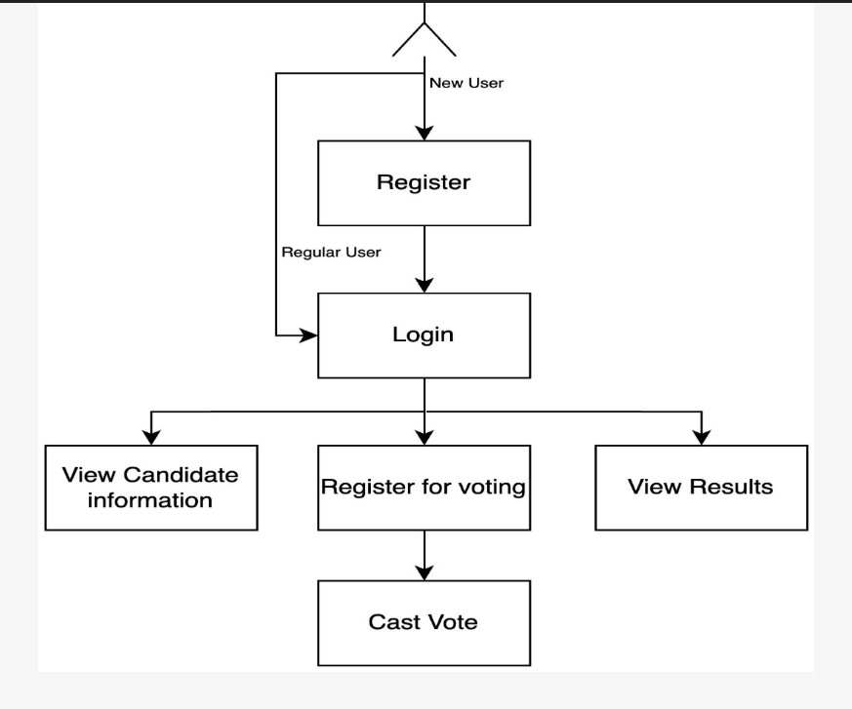
4.SYSTEM ARCHITECTURE

Slide 8
5. TECHNOLOGY USED
SOFTWARE REQUIREMENETS
FRONT-END
Html
Css
Javascript
React
BACK-END
Core Java
Advanced Java
DATABASE
Mysql

Slide 9
6. LIVE DEMO

Slide 10
7. APPLICATION
• The web-application for today’mobile and digitally advanced society to participate in the democratic process over the internet.
• The online voting system offers the highest levels of tranceparency, control, securtity and efficiency of election processes.
Remote Accessibility – Enables voters to cast their votes from anywhere in the world, eliminating geographical barriers.
Reduced Human Errors – Automates vote counting and verification, minimizing the chances of miscounts and fraudulent activities.
Eco-Friendly Approach – Eliminates paper ballots, reducing environmental impact and promoting a sustainable voting process.

Slide 11
8.CONCLUSION
• From the technical point of view, it would be possble to implement an VOTIFY system, but there are deficiences in how the verifiabiliyt and the prevention of pressuring voters could be reconciled.
• This is a e-voting system is able to validate the voters;s identity well and prevent repeating the election.
• This is e-voting system that can store data safely and reliable.
• By using this electoral system, the voting process will be much faster and safer.
• The voting process and the calculation of the number of votes will be faster because the voting process is done in real-time.

Slide 12
THANK YOU

